Slide 1
Environmental Factors And Population Growth: Impact On Malaria Cases In The USA
Tushar Rewatkar (12202513)
Siddhi Gunaji (12201642)

Slide 2
TABLE OF CONTENTS
01
02
03
Yearly trend of malaria cases
04
05
06
Impact of population
CONCLUSIONS
Impact of different environmental factors
monthly trend of malaria cases
Distribution of cases across different states

Slide 3
INTRODUCTION
Examine the trend of Malaria cases in the United States between 2012 and 2017.
Variations in temperature and rainfall can change the habitats and breeding habits of mosquitoes, affecting how malaria is transmitted.
Analyze the population growth that have contributed to the increase in the number of cases.

Slide 4
Yearly trend of malaria cases in usa
01

Slide 5
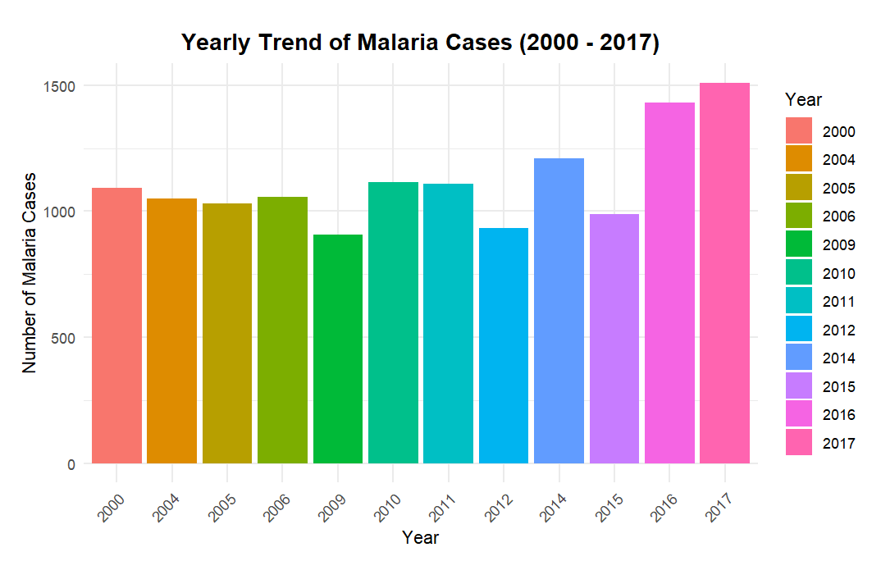
Year: 2000 tO 2017
In the trend from 2000 to 2012 there is not much variation in number of cases

Slide 6
Year: 2000 tO 2017
The data from 2012 to 2017 has a yearly increase in the number of instances.

Slide 7
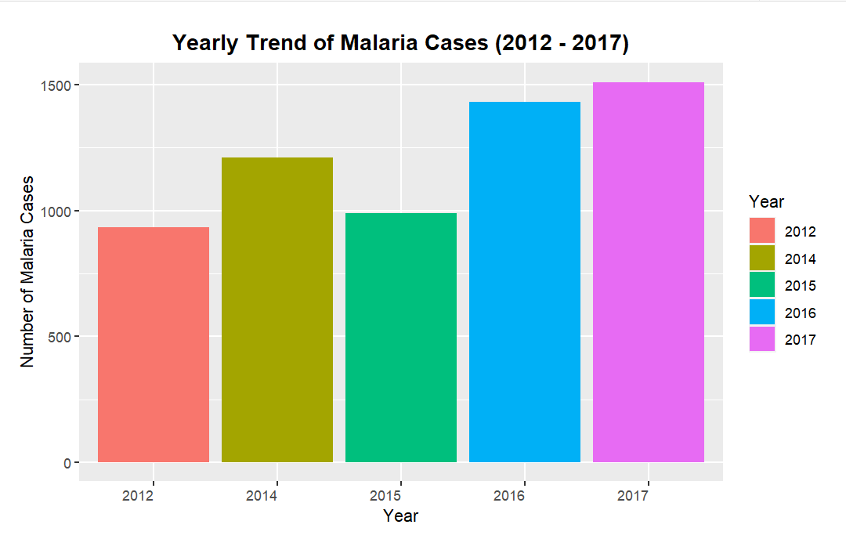
Year: 2012 tO 2017
There have been sharp rises in the number of cases each year.

Slide 8
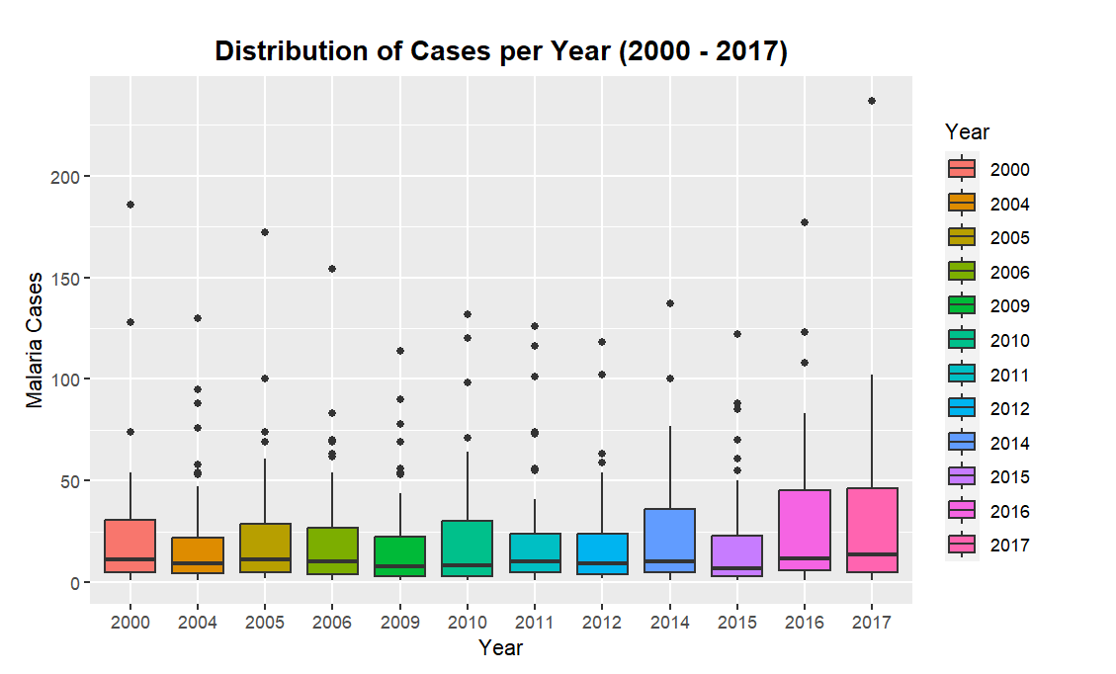
Year: 2000 tO 2017
The Box plot shows the distribution of malaria cases per year per State in US
Observation: more instances were allocated in the years 2016 and 2017.

Slide 9
monthly trend of malaria cases in usa
02

Slide 10
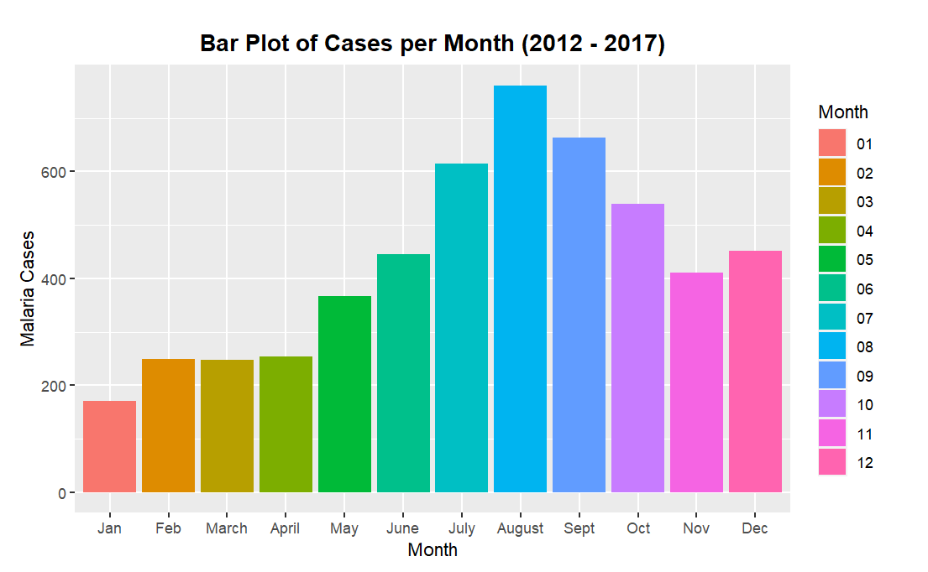
Year: 2012 tO 2017
Observation: The number of cases that occur in this time period is clearly seasonal, with July, August, and September having the highest number of cases.

Slide 11
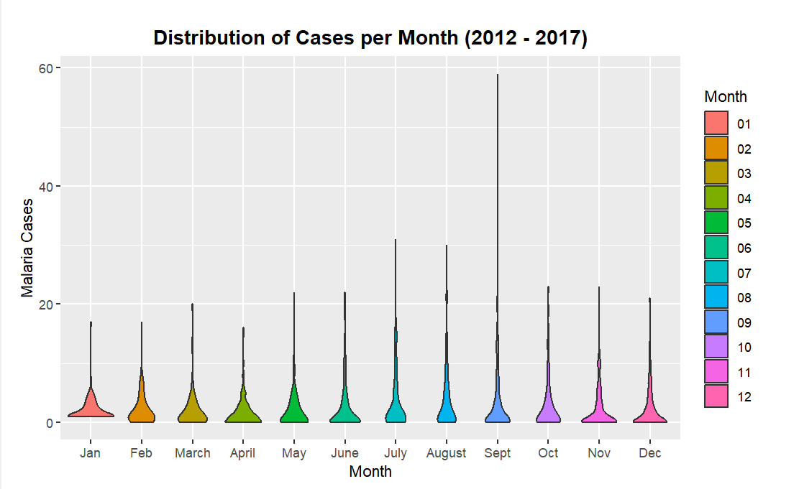
Year: 2012 tO 2017
The Violin plot represents the distribution of malaria cases per month across all states.
This too, clearly shows that data have seasonality.

Slide 12
Distribution of cases across different states
03

Slide 13
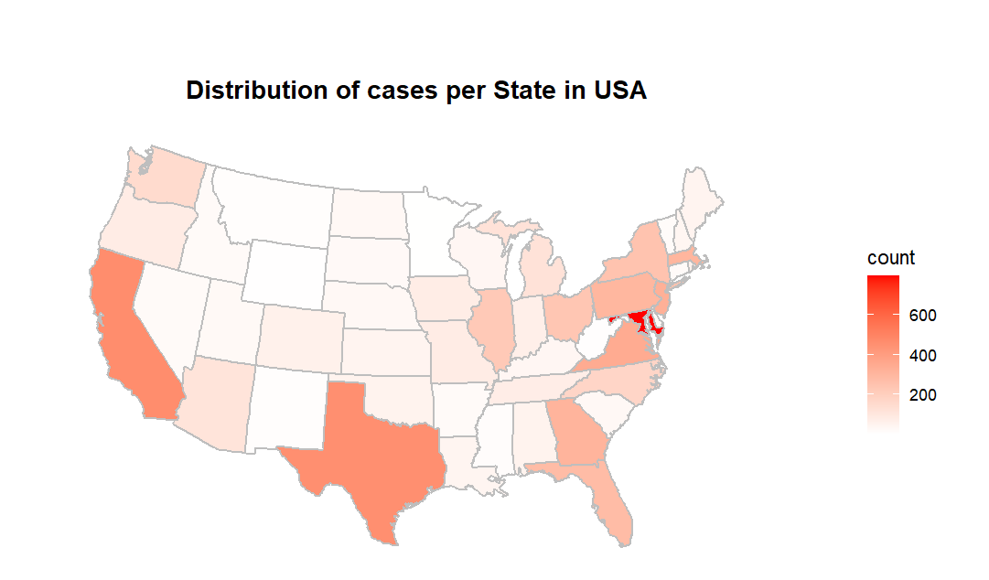
Year: 2012 tO 2017

Slide 14
Year: 2012 tO 2017
California
Maryland
Texas

Slide 15
Year: 2012 tO 2017
You can observe that most of the cases occurred in coastal regions of USA.
It’s an interesting fact to be noted.
California
Maryland
Texas

Slide 16
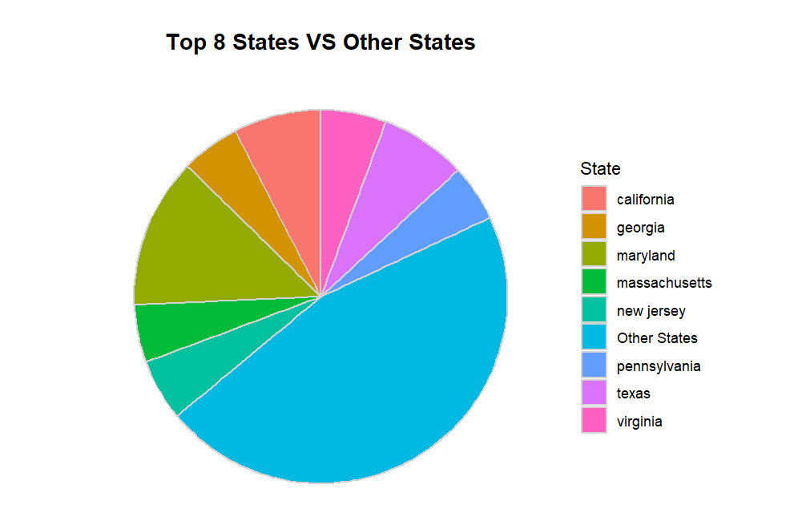
Comparison of malaria cases

Slide 17
Comparison of malaria cases
It is observed that out of the 52 states in the US,
the distribution of cases in the top eight coastal states is GREATER than the rest of the states combined.

Slide 18
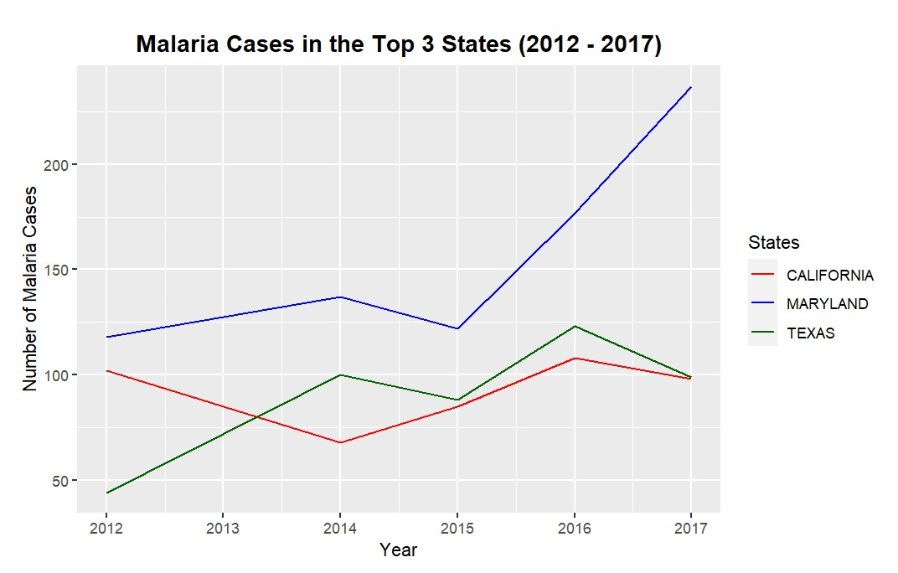
top 3 Malaria Cases (2012 – 2017)
It can be clearly seen that Maryland has had the highest number of cases from 2012 to 2017.

Slide 19
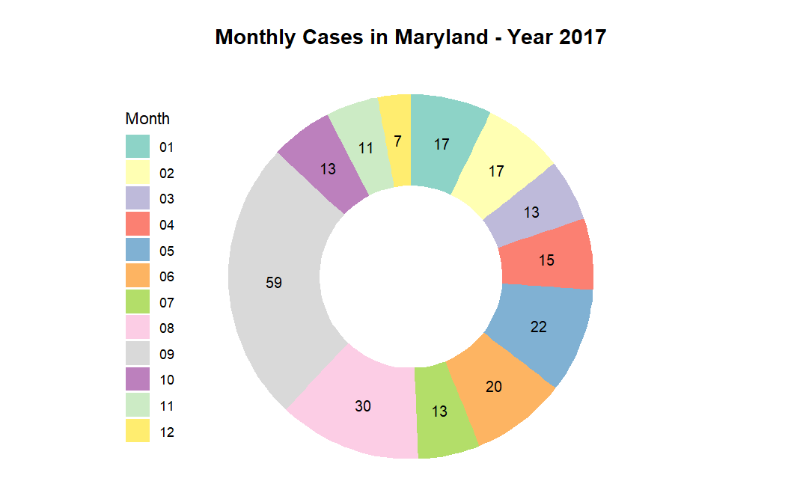
Maryland‘s malaria cases in 2017

Slide 20
04
Impact of different environmental factors

Slide 21
Environmental factors
rain
Rainfall
drought
Palmer Drought Index
temperature
Temperature Value

Slide 22
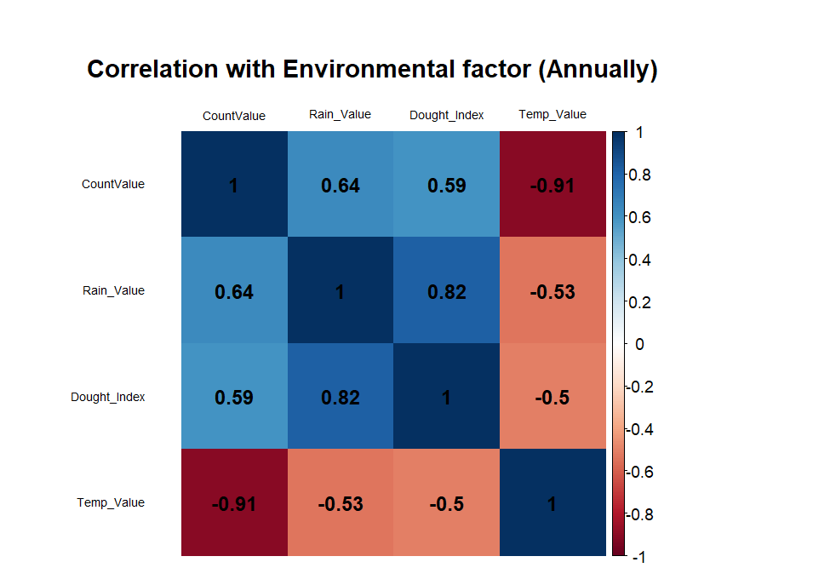
Correlation of environmental factors with malaria
The correlation plot is for CALIFORNIA
Year: 2012 to 2017 (Annual data)
Considering annual data, malaria cases are highly correlated with annual rainfall.
But could Annual data capture the nuances of seasonal changes as effectively as monthly data?

Slide 23
Correlation of environmental factors with malaria
Temperature value is negatively correlated with Count values.
And drought value is positively correlated.
Therefore, it is essential to thoroughly examine the temperature data.

Slide 24
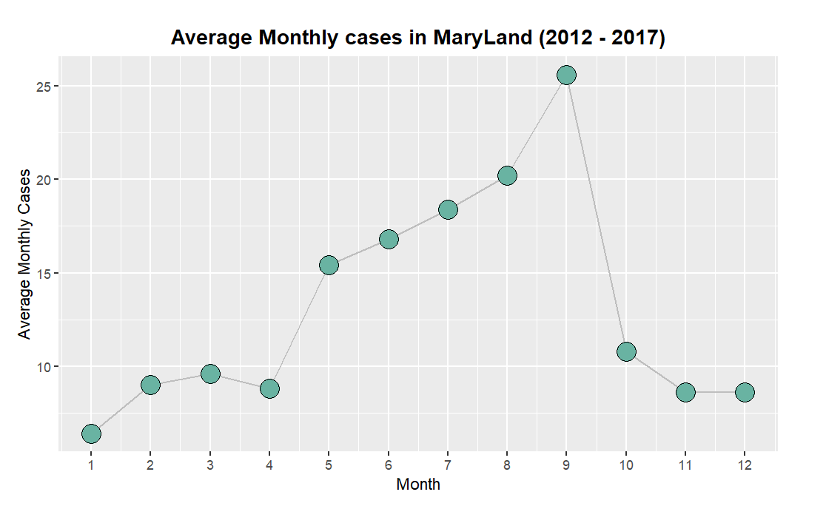
Correlation of environmental factors with malaria
Monthly data provides a better understanding of seasonal changes.
The plot shows variations in average malaria cases across different months.
Observation: Seasonality from June to October.

Slide 25
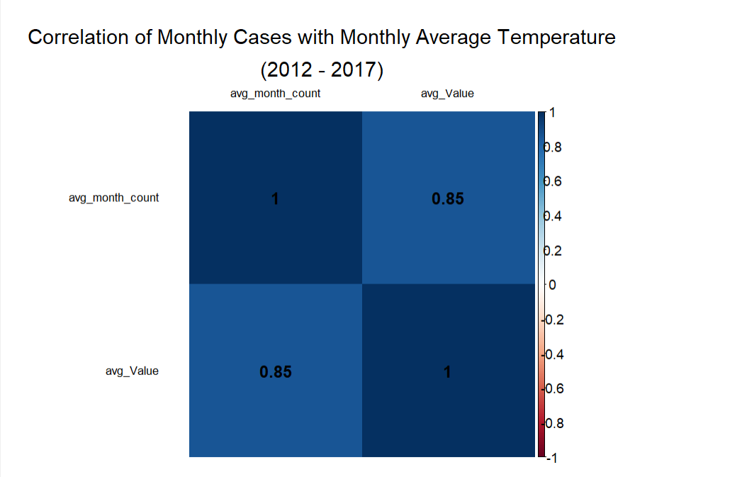
Correlation of environmental factors with malaria
Because of this seasonality, we created a heatmap of the average monthly cases versus the average monthly temperature in Maryland from year to year.

Slide 26
Correlation of environmental factors with malaria
This concludes that temperature is leading to an increase in the number of cases from month June to September.

Slide 27
05
Impact of population

Slide 28
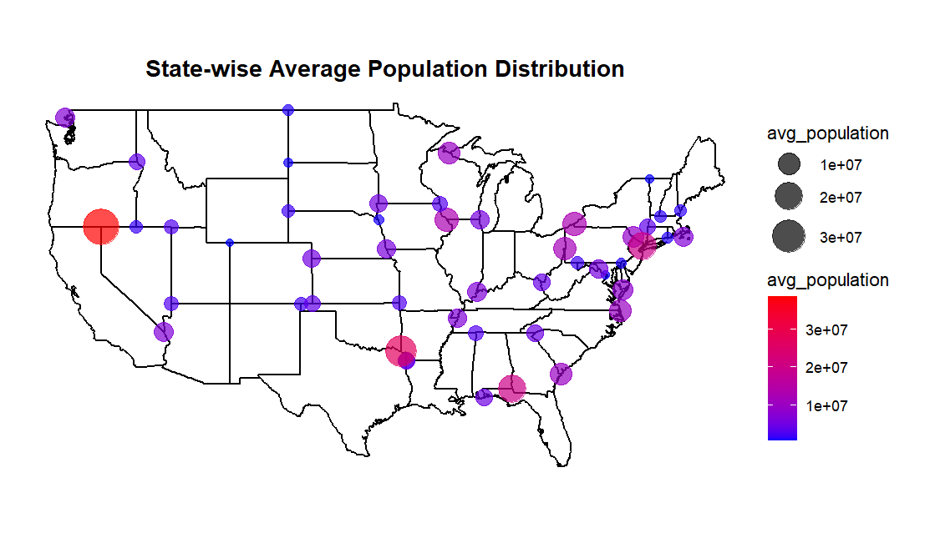
Correlation of population with malaria

Slide 29
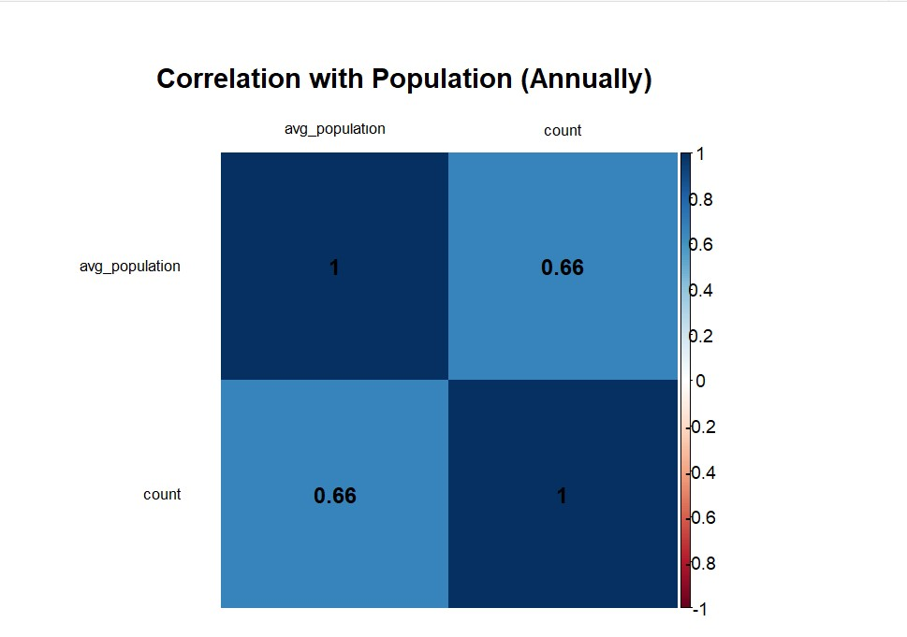
Correlation of population with malaria
The correlation plot is for all states
Year: 2012 to 2017 (Annual data)
It illustrates a positive correlation of 0.66 between malaria cases and avg. population count, indicating a tendency for higher population areas to have a higher incidence of malaria.

Slide 30
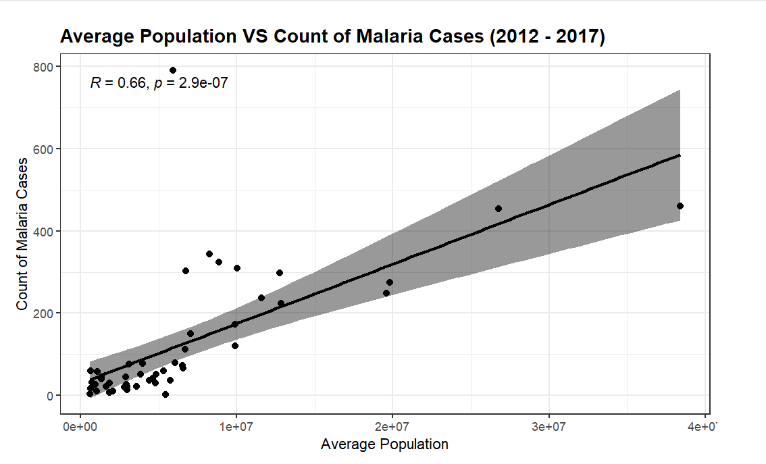
Correlation of population with malaria
The graph clearly shows a state having high population density is more vulnerable to Malaria.

Slide 31
observations
From year 2012 to 2017 we can find the increase in number of cases year by year all over USA.
In 2017 we observed highest number of Malaria cases.
It can be observed that Maryland, California and Texas have been reported highest number of Malaria disease cases and, we have seen how environmental factors are affecting it as well as well Population of state.
We also observed seasonality in a year which were proven with the heatmap of temperature with the number of cases.

Slide 32
conclusion
Our Analysis has revealed how Environmental factors are affecting the malaria cases in USA from 2012-17.
We discussed that the number of cases are high in US coastal regions.
A positive correlation between the rainfall and Palmer drought index factor show how both factors leading to increase in number of cases.
Population density is another reason for increase in the number of malaria cases
We also discussed the impact of seasonality; this was proven with positively correlation of Average monthly temperature with average monthly malaria count from year 2012-17.

Slide 33
Questions?
Thankyou

